Slide 1
5260: Mathematical Models for Decision Making (Constrained Optimization)
Gareth Green
greeng@seattleu.edu

Slide 2
Mathematical Models for Decision Making
Construct mathematical models that represent the essence of real problems to support decision making
Model supported decisions, not model driven
Models will not give absolute correct answer
Give relative answers for comparing different courses of action (decisions)
Will illuminate trade-offs of different courses of action
Model only as good as structure and data you used. Garbed in Garbed out!
Is not the Decision! It is a simplification of the reality!

Slide 3
Modeling process
A question well put is half of the solution!
Observe, understand and define the problem, including gathering data (est parameters) The parameters are not the goal, but the mean
Formulate a mathematical model representing the essential features of the situation You don’t start programming the model! First graph the problem and talk with others! It is an interactive problem and not linear!
Program the model using problem structure, computer program and data
Model validation: test and refine the computer model Does the model make scenes in the reality?
Implement the model into business operation

Slide 4
Understand and define the problem
What are the most important and difficult parts of solving a problem?
Understanding the critical components of the situation to set up problem structure
Understand goals and objectives (Bring stakeholders together!)
Know important constraints, could be across many areas of operation
A great answer with the wrong problem structure is useless, or worse dangerous
Determining the parameters of the model—based on data!
Parameters are statistically estimated if have data
If no data based on “professional opinion”—best guess
Likely no data on new product, service, operation, etc
Update guess with data as learn about new activity

Slide 5
Understand and define the problem
The problem is the objective function and the constraints
Too often analysts jump to programming the problem w/o understanding it
In talking to recruiters, employers and the advisory board…
Must spend time understanding ALL dimensions of a problem
What are true objectives?
What are constraints and interconnections?
Consider system wide impacts of a problem
Interrelations with all portions of a business

Slide 6
Understand and define the problem
Once understand the problem:
How do components of the system interact?
How capture objectives, constraints (structure) and find parameters (data)?
Formulate mathematical model

Slide 7
Constrained optimization
This course is generally about Constrained Optimization
Doing the best with what you have
What does best mean?
max profits, max services, min costs, min time, etc
For each of these there is an objective function
Mathematical representation of profit, services, cost, time
The goal you are maximizing or minimizing

Slide 8
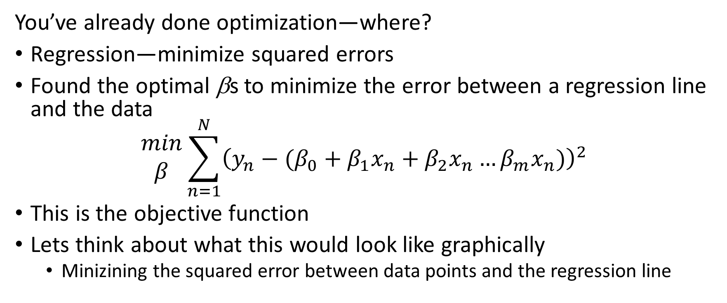
Constrained optimization
You’ve already done optimization—where?
Regression—minimize squared errors
Found the optimal βs to minimize the error between a regression line and the data
$$\begin{matrix}min \\ β\end{matrix}\sum_{n=1}^{N}{{\left(y_{n}−(β_{0}+β_{1}x_{n}+β_{2}x_{n}…β_{m}x_{n})\right)}^{2}}$$
This is the objective function
Lets think about what this would look like graphically
Minizining the squared error between data points and the regression line

Slide 9
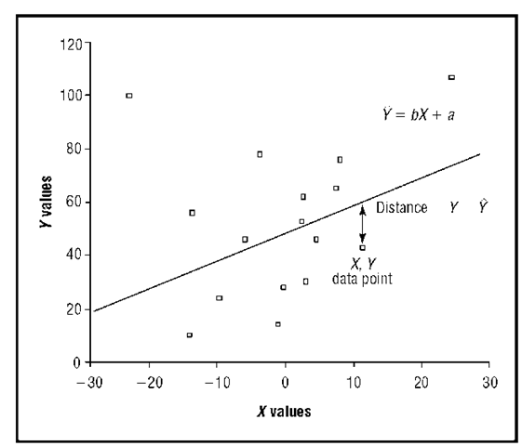
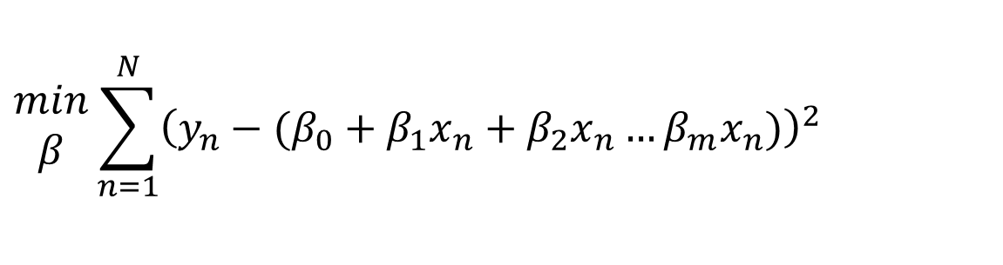
$$\begin{matrix}min \\ β\end{matrix}\sum_{n=1}^{N}{{\left(y_{n}−(β_{0}+β_{1}x_{n}+β_{2}x_{n}…β_{m}x_{n})\right)}^{2}}$$

Slide 10
Constrained optimization
OLS or GLM—nonlinear unconstrained optimization
Nonlinear
The involved function(s) were not linear
Least squares is quadratic
Unconstrained—the βs could take on any value
There are no constraints on achieving the minimum (more obvious soon)
What type of constraints could you add?
β_{i} ≥ 0 or ∑_{i}β_{i} = 1

Slide 11
Linear-constrained optimization
Objective function
A firm produces and sells 2 products, Boots (B) and Shoes (S)
Boots earn $40 of profit/pair and Shoes earn $25 of profit/pair
The firms objective is to maximize profits (common but inaccurate assumption)
Objective function for production is: π = 40B + 25S
Is linear in variables and structure (all variables summed
What if π = 40B + 25S – 5BS or π = 40B + 25S²?
No longer linear in structure since B and S are multiplied or in variables since S²

Slide 12
Linear-constrained optimization
Constraints
It takes 30 labor hours to make Boots and 20 labor hours to make shoes
The firm has a maximum of 1200 labor hours per production period
30B + 20S ≤ 1200
Boots require 10 hours of machine time and shoes require 10 hours
There are 500 machine hours
10B + 10S ≤ 500
There is only demand for 30 pair of boots, B ≤ 30
Note all constraints are linear in variables and structure
If objective and all constraints are linear cannot solve with calculus

Slide 13
Linear-constrained optimization
Goal is to max/min the objective while staying within constraints
Formally the problem is stated as:
max _{B,S} p = 40B + 25S
subject to: 30B + 20S ≤ 1200 functional constraints
10B + 10S ≤ 500
B ≤ 30
B ≥ 0, S ≥ 0 non-negativity constraints
B and S are the decision variables or activities
Select optimal level of B and S to maximize profits
40, 25, 30, 20, 10, 10, 1200, 500 and 30 are parameters
Estimated statistically or “expert opinion”
This is a typical Resource Allocation Linear Programming model

Slide 14
Linear-constrained optimization
Set up problems 1 & 2 on handout
That is, do step 2 of the modeling process
Note, step 1 define the problem is already done
Come back to the next video when you are done

Slide 15
Graphical solution of a Linear Programming model
Use visualization to illustrate this simple model
Only two decision variables so easy to graph
Could think of this as a 3D problem
Recall the problem was set up as:
max _{B,S} π = 40B + 25S
subject to: 30B + 20S ≤ 1200
10B + 10S ≤ 500
B ≤ 30
and S ≥ 0
B ≥ 0
Lets build this graph and the feasible region
Begin by building backward
S
60
50
30
15
Labor hour constraint
Objective function
Demand constraint
Machine hour constraint
20 30 40 50 B

Slide 16
Review the Graphical Method for Solving Linear Programs
Formulate the problem as a linear program
Plot the constraints
Identify the feasible region
Draw an imaginary line parallel to the objective function
Find the optimal solution

Slide 17
Review graphical solution method
Simple constraints (no algebra for graphing) : B ≥ 0, S ≥ 0 and B ≤ 30
See how feasible region changes as add 3rd constraint (0 ≤ B ≤ 30)
Feasible region shows the possible values of B and S
Constraints with both variables require algebra for easy graphing
10B + 10S ≤ 500 → 10S ≤ 500 – 10B → S ≤ 50 – B (slope = –1)
Graph based on 2 points: B = 0, S = 50 and S = 0, B = 50
What happens to feasible region?
30B + 20S ≤ 1200 → 20S ≤ 1200 – 30B → S ≤ 60 – 3/2B (slope = –3/2 = –1.5)
Graph based on 2 points: B = 0, S = 60 and S = 0, B = 40
What happens to feasible region?

Slide 18
Review graphical solution method
Note the constraints indicate the feasible solutions
Feasible solution is a solution where all constraints are satisfied
Solution will be at a corner of the feasible region since constraints and objectives are linear
There are 5 corners (B, S):
i (0, 0)
ii (0, 50)
iii (20, 30)
iv (30, 15)
v (30, 0)
How find these? Use algebra to solve for B and S of binding constraints

Slide 19
Review graphical solution method
Graph objective function
π = 40B + 25S → 25S = π – 40B → S = π/25 – 8/5B (slope = –1.6)
But we do not know what π is so do not have an intercept
Instead we can use a slope-line to identify the maximum graphically
Note that slope of objective –1.6 is steeper than slope of both objective constraints
Indicates the solution (profit max) will be at a boundary (i.e. constraint)
What if slope of objective function is –1.5 < slope obj < –1?
What if slope of objective function is –1 < slope obj?
Using the objective function slope-line method we can find the optimal solution
Optimal solution satisfies constraints and maximizes the objective function
Optimal solution is B = 30, S = 15, π = 1575

Slide 20
Properties of linear programming solutions
An optimal solution must lie on the boundary of the feasible region
There are exactly four possible outcomes of linear programming:
A unique optimal solution is found
An infinite number of optimal solutions exist
No feasible solutions exist
The objective function is unbounded (there is no optimal solution)
If an LP model has one optimal solution, it must be at a corner point
If an LP model has many optimal solutions, at least two of these optimal solutions are at corner points.

Slide 21
The Simplex method
Discussed extensively in the text
The simplex method algorithm:
Start at a feasible corner point (often the origin)
Check if adjacent corner points improve the objective function:
If so, move to adjacent corner and repeat step 2
If not, current corner point is optimal, stop
S
60
50
30
15
20 30 40 50 B

Slide 22
Program the model for computer solution
Many programs available, but we will use R
R is NOT the best, but our goal here is to learn optimization and decision models
Not become expert optimization programmers
If you begin doing significant optimization you will learn other software
LINDO, GAMS (General Algebraic Modeling System), CPLEX, etc
See all Optimization Packages in R go to https://CRAN.R-project.org/view=Optimization
Begin with two R packages:
lpSolve
lpSolveAPI
Go to class code
Install packages from CRAN
You should review documentation

Slide 23
Program the model for computer solution
Using R to solve the model above we find:
B = 30, S = 15 and π = 1575
Is apparent the boot demand constraint is binding since B = 30
Binding means that the constraint is limiting profitability
Production has met the constraint of demand
If demand for boots were higher we could increase profits by producing more boots
Would also change the optimal S – WHY?
Labor hours constraint 30B + 20S = 30*30 + 20*15 = 1200
The labor hours constraint is binding
If we could hire more labor could increase profit
Machine hours constraint 10B + 10S = 10*30 + 10*15 = 450 ≤ 500
Not binding, so NOT using machines to capacity

Slide 24
Results
What are some recommendations we can make based on these results?
Firm can increase profits if increase demand for boots—marketing?
Firm can increase profits if they hire more labor—use full capacity of machines
NOTE: factors not meeting constraint do NOT limit the objective function
Machine hours not limiting profitability, not using full capacity
Could think this is to reduce maintenance, but that should have been built into the constraint
Could incorporate a constraint that increased cost as increased machine hours to model maintenance costs

Slide 25
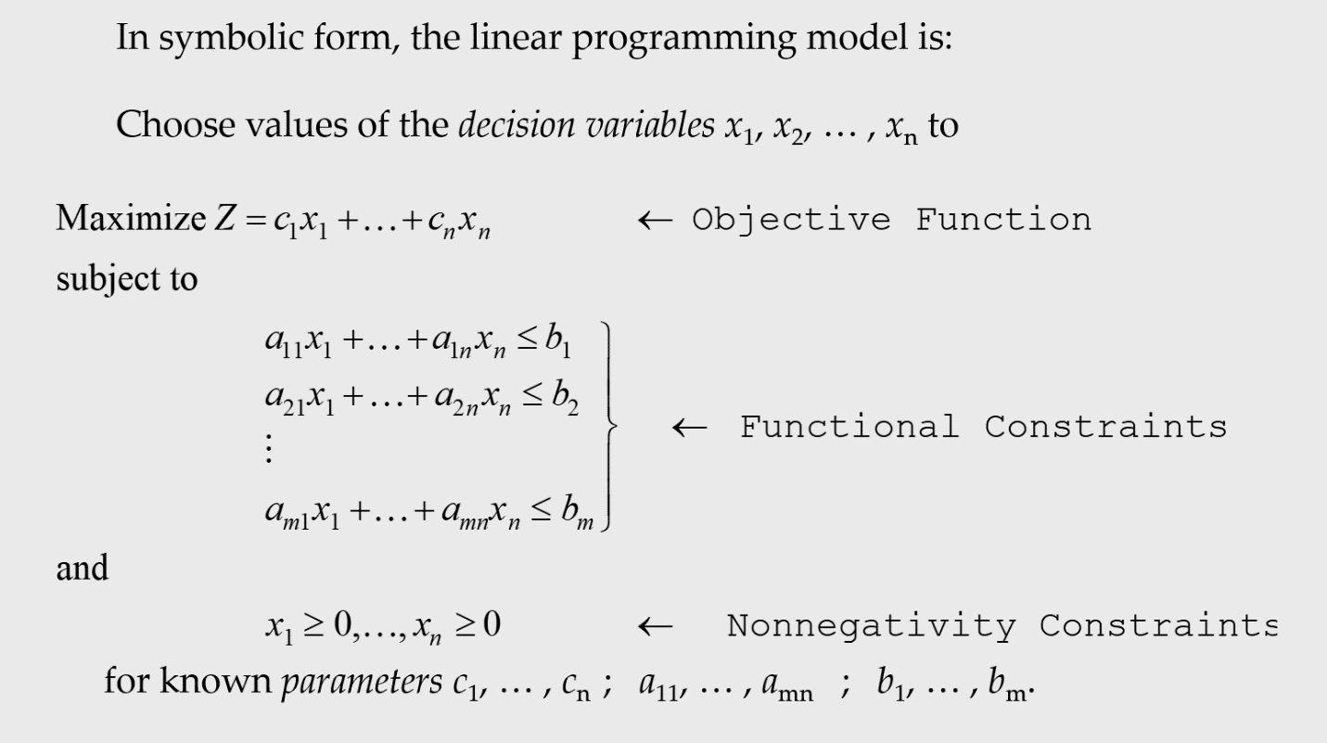
Sensitivity analysis—general model structure

Slide 26
Sensitivity analysis—conceptual
From the graphical depiction we can see how the optimal solution depends on a’s, b’s & c’s
If the objective function or constraints change, then the optimal solution may change
c’s change the slope-line of the objective function will change
b’s change will shift the constraints in or out
a’s change the intercept and slope of constraints will change
maximize _{x, y} Z = c₁x + c₂y
subject to: a₁₁x + a₁₂y ≤ b₁
a₂₁x + a₂₂y ≤ b₂
a₃₁x ≤ b₃

Slide 27
Sensitivity analysis—conceptual
How does changing parameters effect the results?
c’s change the slope-line of the objective function will change
b’s change will shift the constraints in or out
a’s change the intercept and slope of constraints
S
60
50
30
15
20 30 40 50 B

